Slide 1
RFM Analysis
Online Retail Store Purchase

Slide 2
Objective
To analyze customer purchase behavior from the last few years

Slide 3
Basic Customer Data Overview
Customers 2503
Orders
254048
Total Sales
589653.52
No. of sales orders with Unidentifiable Customers
5743

Slide 4
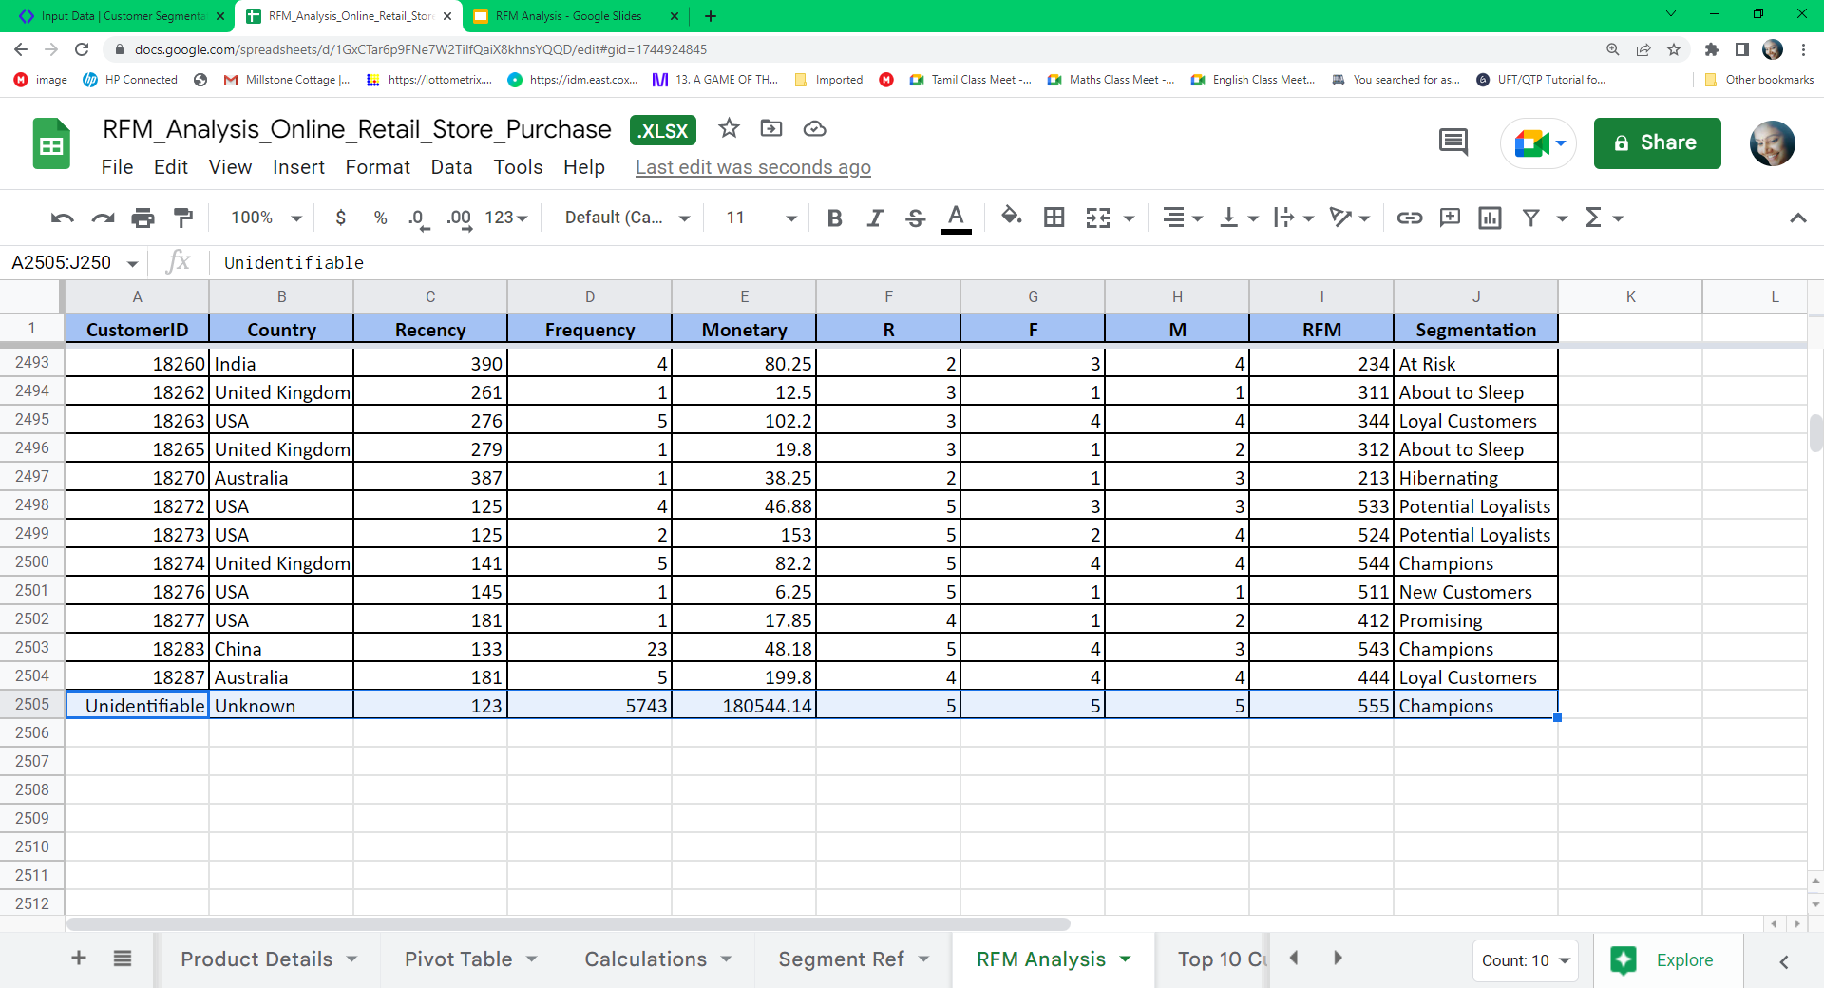
Sales Orders without Customer ID

Slide 5
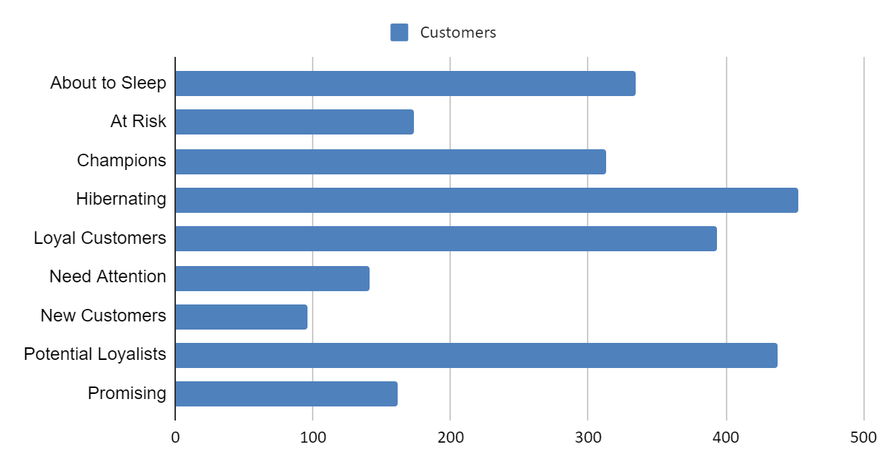
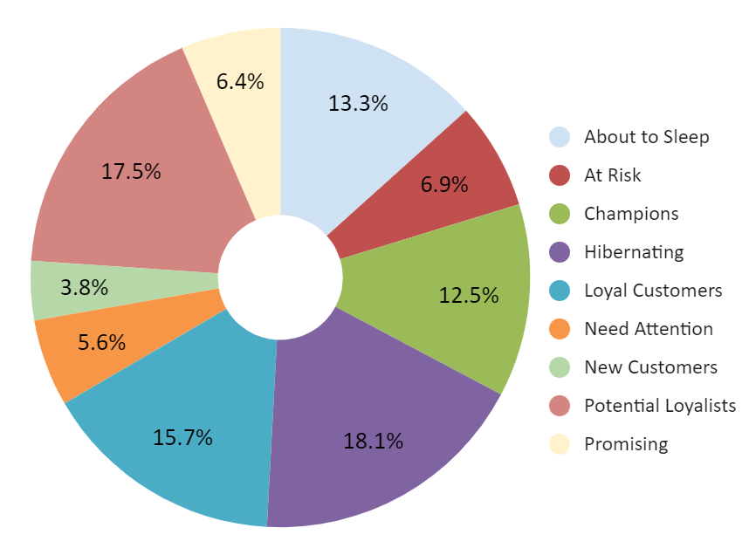
Distribution of Customers in Segments

Slide 6
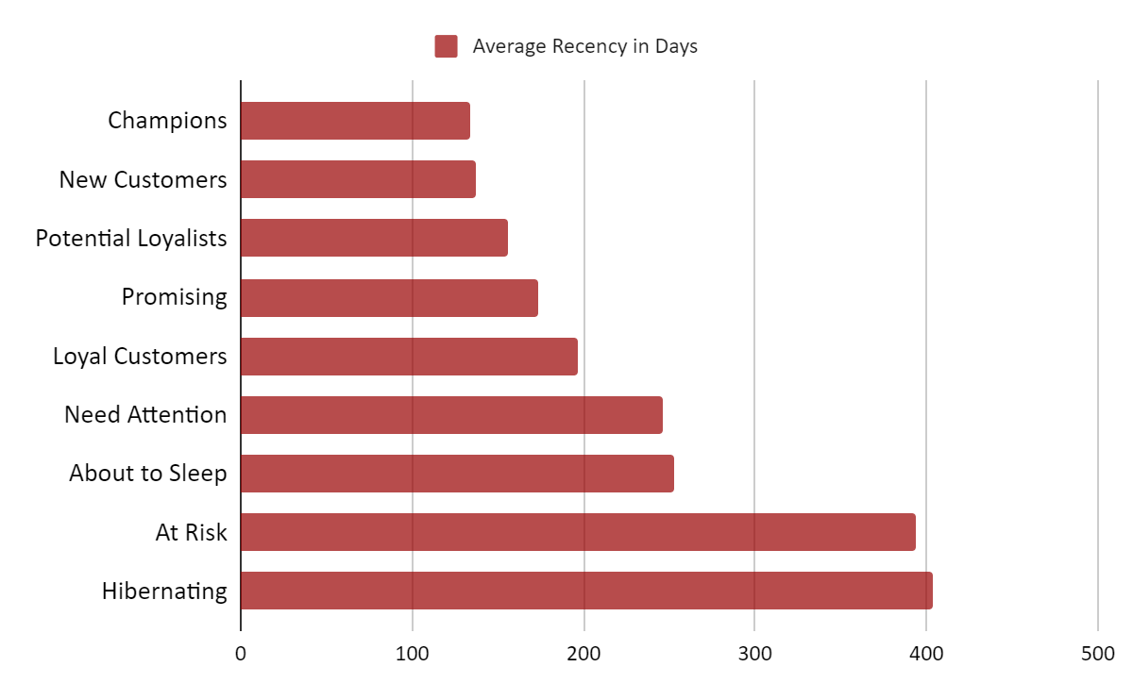
Average Recency in Days

Slide 7
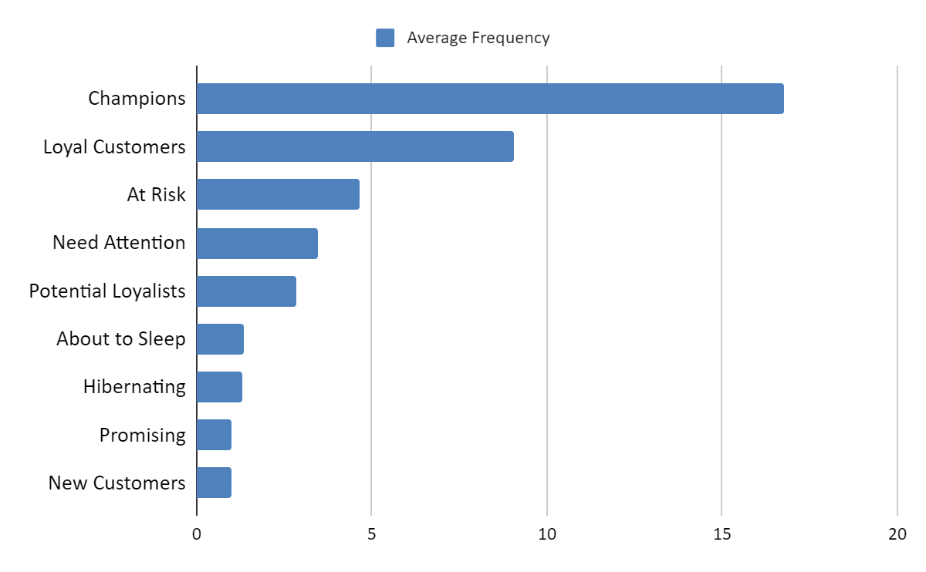
Average Frequency

Slide 8
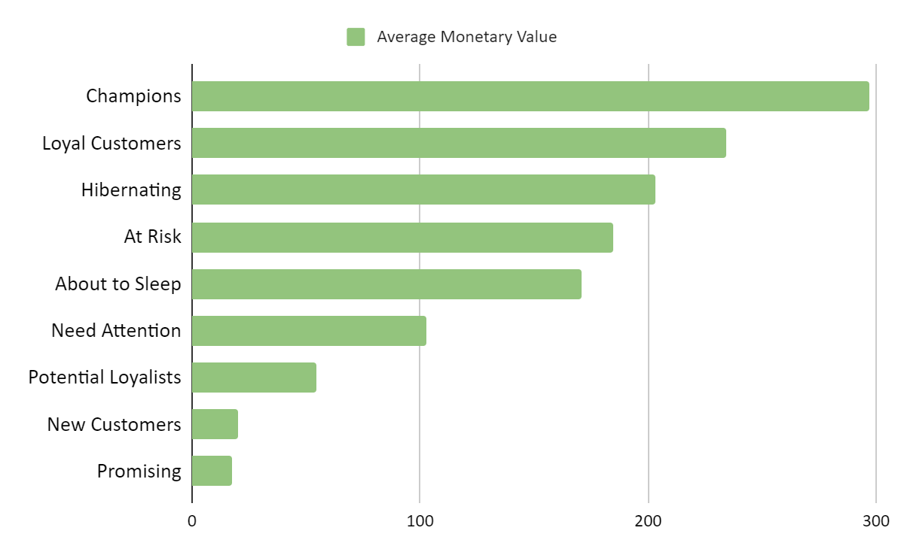
Average Monetary Value

Slide 9
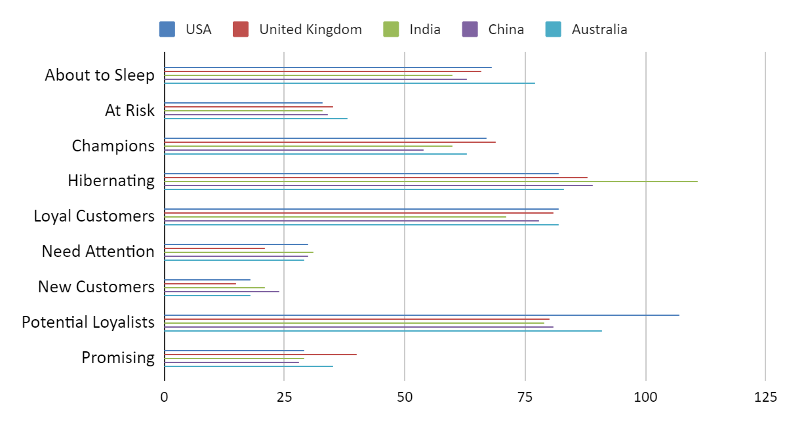
Distribution of Customer Segments in Country

Slide 10
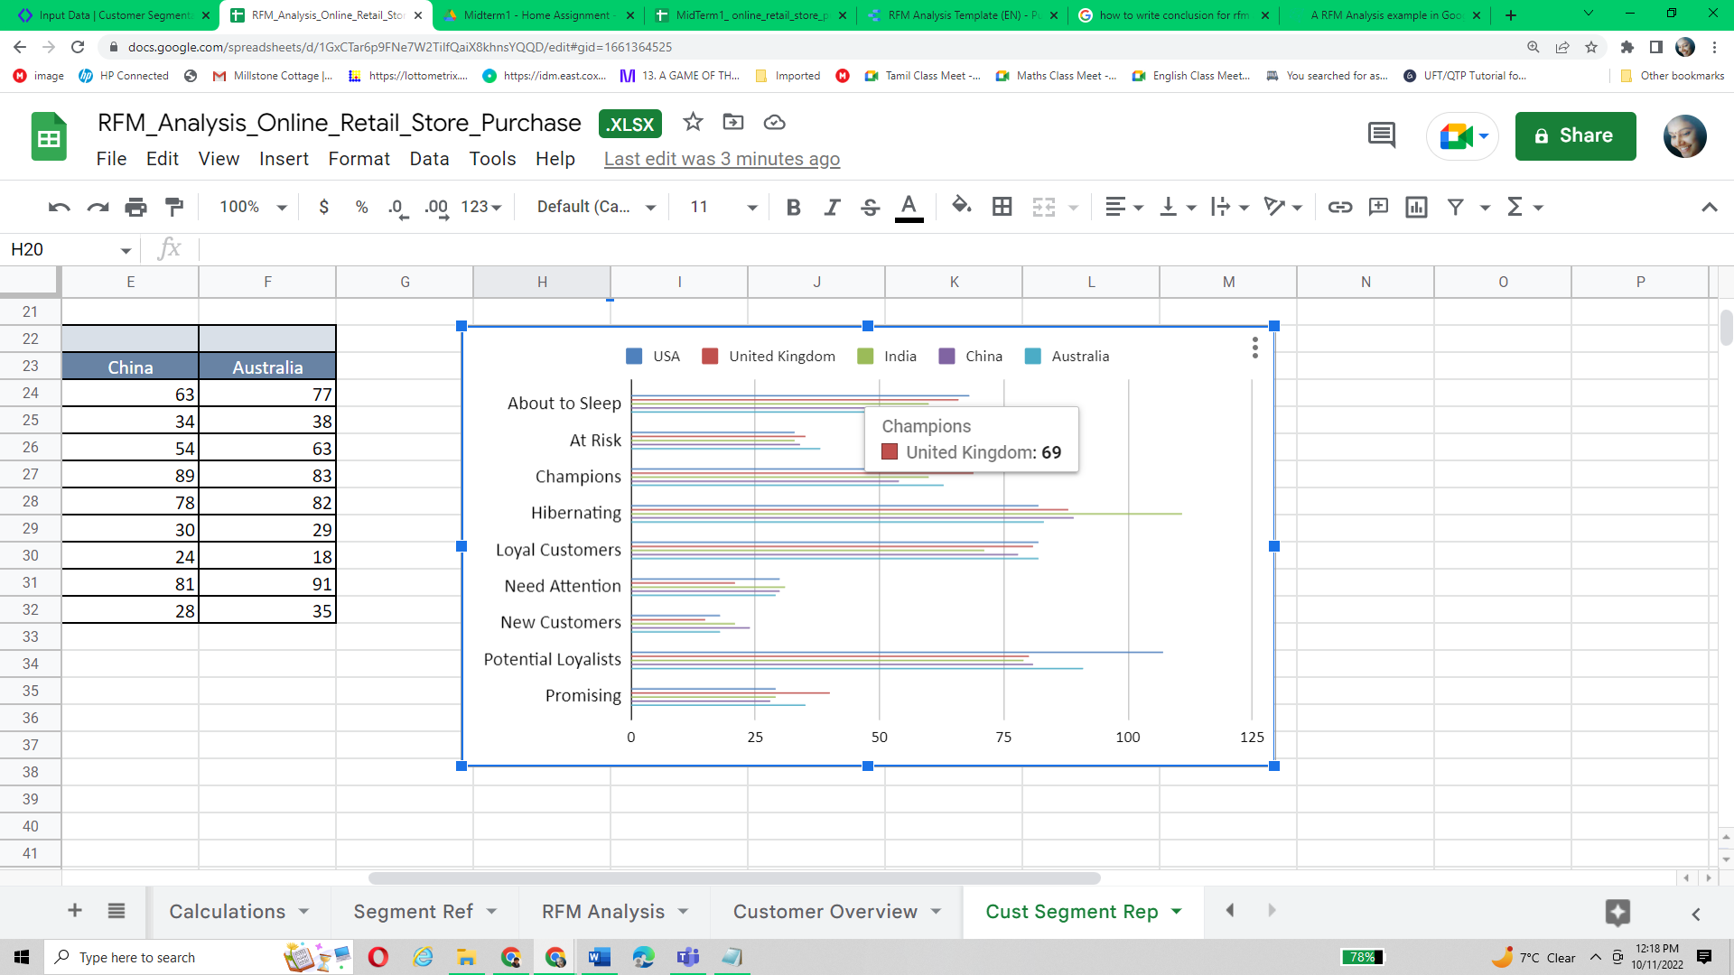
Distribution of Customer Segments in Country

Slide 11
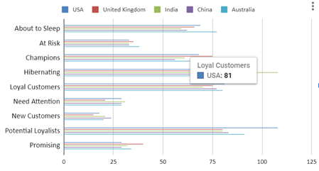
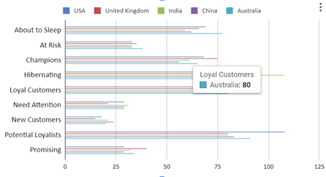
Distribution of Customer Segments in Country

Slide 12
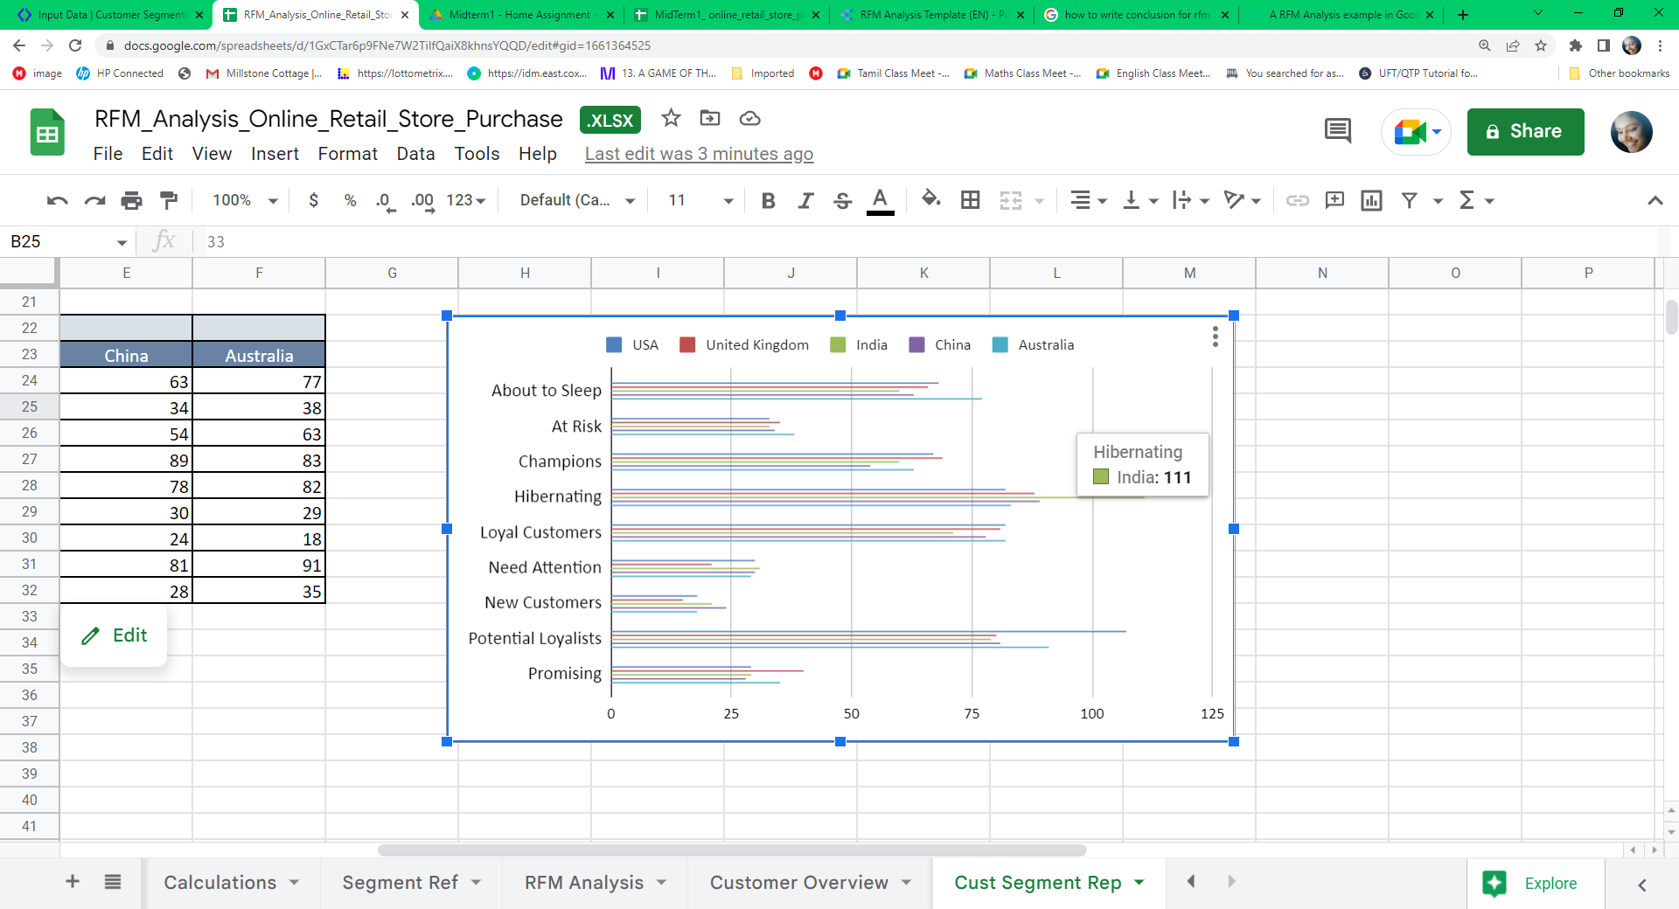
Distribution of Customer Segments in Country

Slide 13
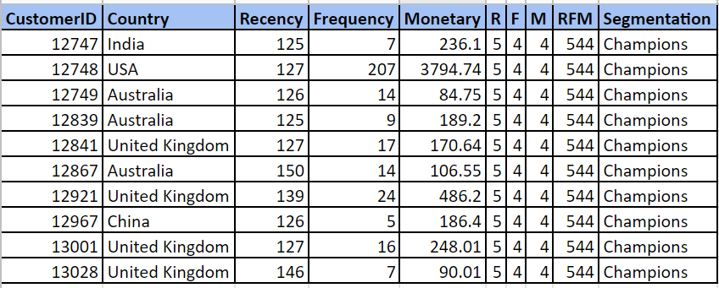
Top 10 Customers of Champions Segment

Slide 14
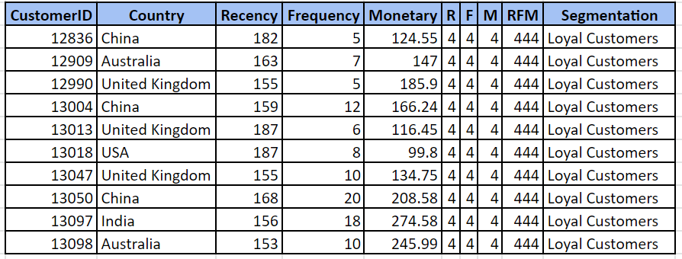
Top 10 Customers of Loyal Customers Segment

Slide 15
Conclusion
Champions - These customers are the most valuable customers. They buy frequently and they are spending high amount on each transaction and are still very active. United Kingdom has more Champions.
Loyal Customers - These customers might be spending less frequently or lower amounts than Champions, however, they are still very valuable as they are regular and recent purchasers. USA and Australia have more Loyal Customers.
Hibernating - These customers have not purchased in a long while. India has more Hibernating customers.

Slide 16
References
Link to Google Sheet : https://docs.google.com/spreadsheets/d/1GxCTar6p9FNe7W2TiIfQaiX8khnsYQQD/edit?usp=sharing&ouid=109767145271517920218&rtpof=true&sd=true

